Slide 1
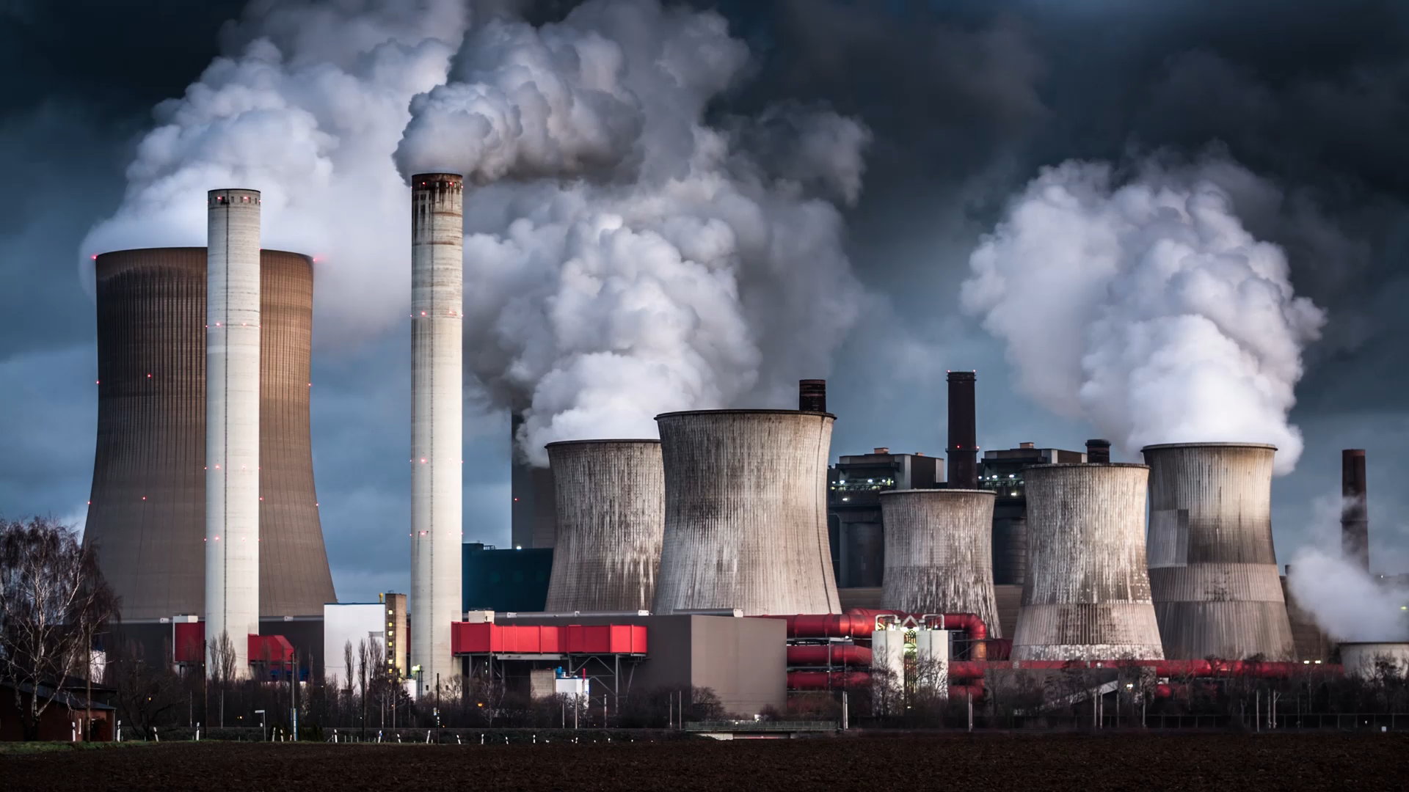
Introduction to Economics and Sustainability

Slide 2

Who am I?
Dana Golden
PhD student in economics
MS degrees in economics and analytics from Georgia Tech
Former economist for Federal Energy Regulatory Commission and USDA Economic Research Service

Slide 3
Goals for the Course
Teach skills that improve employability
Promote economic literacy
Create understanding of sustainability and environmental economics

Slide 4

What is economics and sustainability?

Slide 5
How will you be evaluated?
Recitation Group projects 20%
Essentially a participation grade for activities we do in recitation
Homework 30%
There will be spreadsheet, light coding, and math based homeworks
Quiz Average 20%
Quizzes will not require you to do any math or at least much math. Quizzes will ask you to apply economic reasoning in a novel scenario
Final Project 30%
I will provide a list of possible final projects. You will pick one.

Slide 6

Policy for Quizzes
I will email the topic for the quiz Friday morning
I will be in the room during class time if you want to ask questions or knock the quiz out in person. Also fine to ask questions during office hours
You have no obligation to be here.
You are free to work with anyone you want or use any resources you want, but the writing must be your own, and you must cite partners
By Monday in class, you must turn in by email or in person your quiz
You can only use up to 4 pages handwritten or 2 pages typed (not including any diagrams you are asked to draw)
IMPORTANT: once quizzes are over, you must show up on Fridays!

Slide 7

Plan for the semester
Cover material from Introduction to Sustainable Development and Environmental Economics: An Introduction
Two brief introductions to R and Excel
Activities Fridays after quizzes end
Special topics including energy policy, electricity markets, game theory, and Forecasting

Slide 8
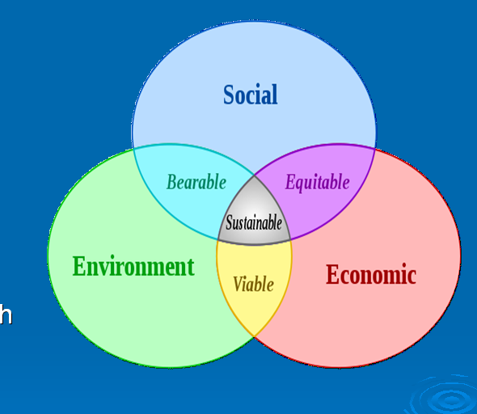

Slide 9
Positive Economics
What is. If A, then B
Descriptive, this is how it works
If supply shifts left ceteris paribus, price goes up

Slide 10
Normative Economics
What ought to be
Ethics, morality, right
Makes decisions for societal priorities
Should we build a neighborhood to make housing more affordable even if that hurts the environment?

Slide 11
Economics is a positive science
Economists cannot tell you the right policy.
They can only tell you the results from various actions.
The question of which outcome is desirable is up to philosophers
Economics involves tradeoffs
Usually no one right answer
Pareto Principle

Slide 12
Factors of Production/Natural Resources
Land: the natural resources
Labor: human capital
Capital: building, machines and inventory used to produce consumer products
Entrepreneurship: organizer of resources/risk taker

Slide 13
Three Economic Activities of Study
Production: activities that determine the amount of goods and services produced. Determined by the factors of production; land, labor, capital and entrepreneurial talent.
Distribution: the way these goods and services are put into the hands of individuals and groups that make up the society. In the US, through the market system and public policy.
Consumption: The final utilization of these goods and services.

Slide 14
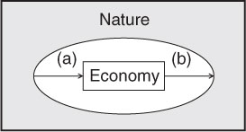
Relationship between the Economy and Nature. What could we add to the diagram?

Slide 15
Incentives
Incentives are given to people to cause people to alter behavior
In Chicago, they paid students to go to school
Attendance rates amongst at-risk youth increased
Carbon taxes decrease carbon emissions
Grades are an incentive for you to study…
Incentives do not always merit correct behavior

Slide 16
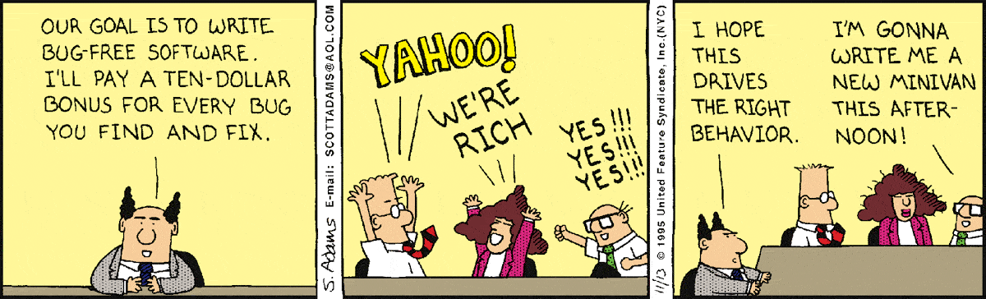
Perverse Incentives

Slide 17
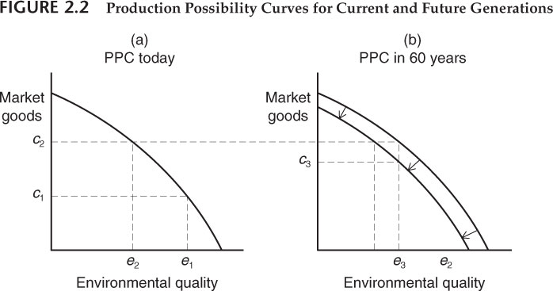
Production Possibilities Curve

Slide 18
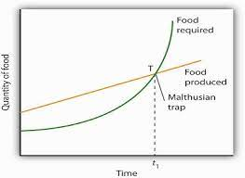
Malthusian Trap

Slide 19
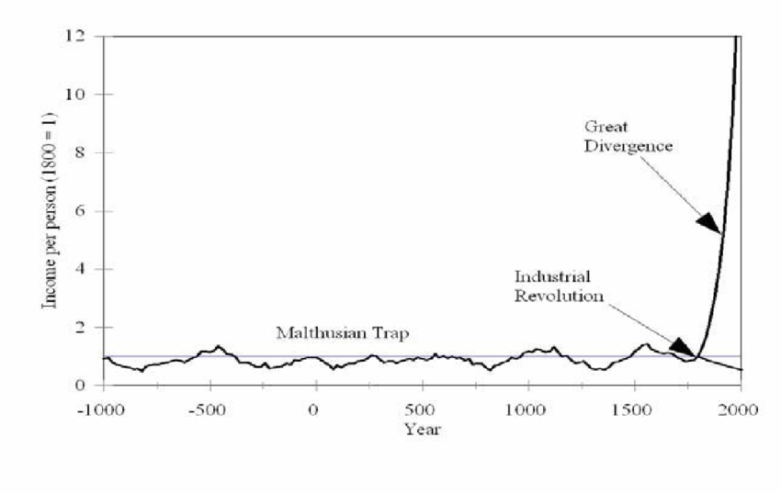
What actually happened?

Slide 20
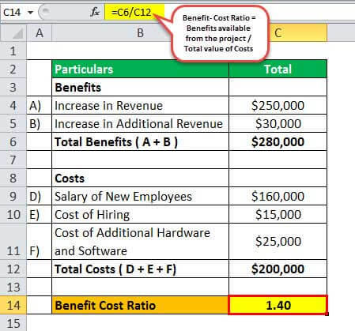
Traditional Cost-benefit Example

Slide 21
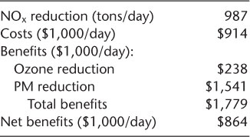
Cost Benefit analysis: Environmental Cost considered

Slide 22
Ways to achieve sustainability
Leave
Leave everything in a pristine state [or return to].
Develop
Develop within the carrying capacity of the system.
Take
Kuznets: sustainability will take care of itself.
Solve
Coase: polluters and victims will solve the problem themselves.
Let
Let the market take care of itself.
Internalize
Internalize the externality.
Let
Let the national economic accounting system reflect defensive expenditures.
Reinvest
Reinvest rents for nonrenewable resources.
Leave
Leave future generations the options to be as well off as we are.

Slide 23
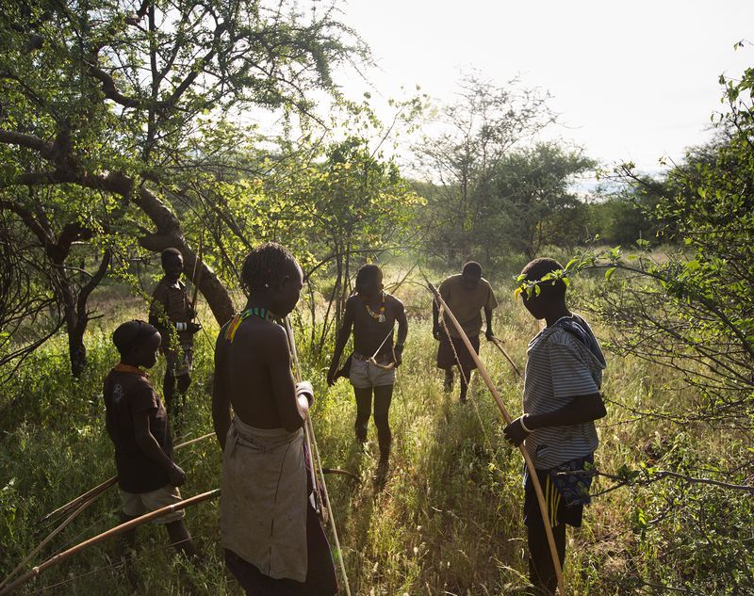
Leave everything in its pristine state

Slide 24

Develop within carrying capacity of the system

Slide 25
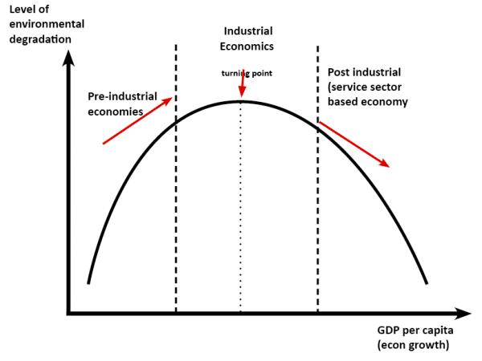
Kuznets Curve: sustainability will take care of itself.

Slide 26
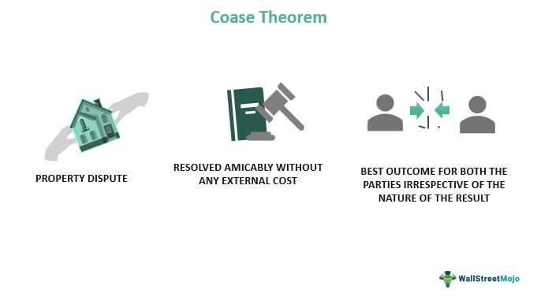
Coase: Let markets take care of it

Slide 27
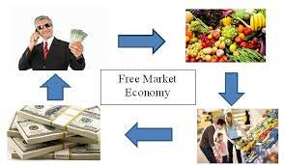
Let Markets Take Care of Themselves

Slide 28
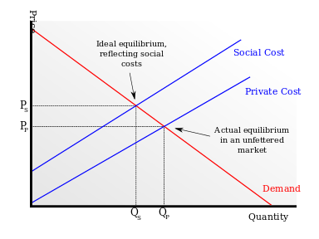
Internalize the Externality

Slide 29

Account for environmental Cost at a national level

Slide 30
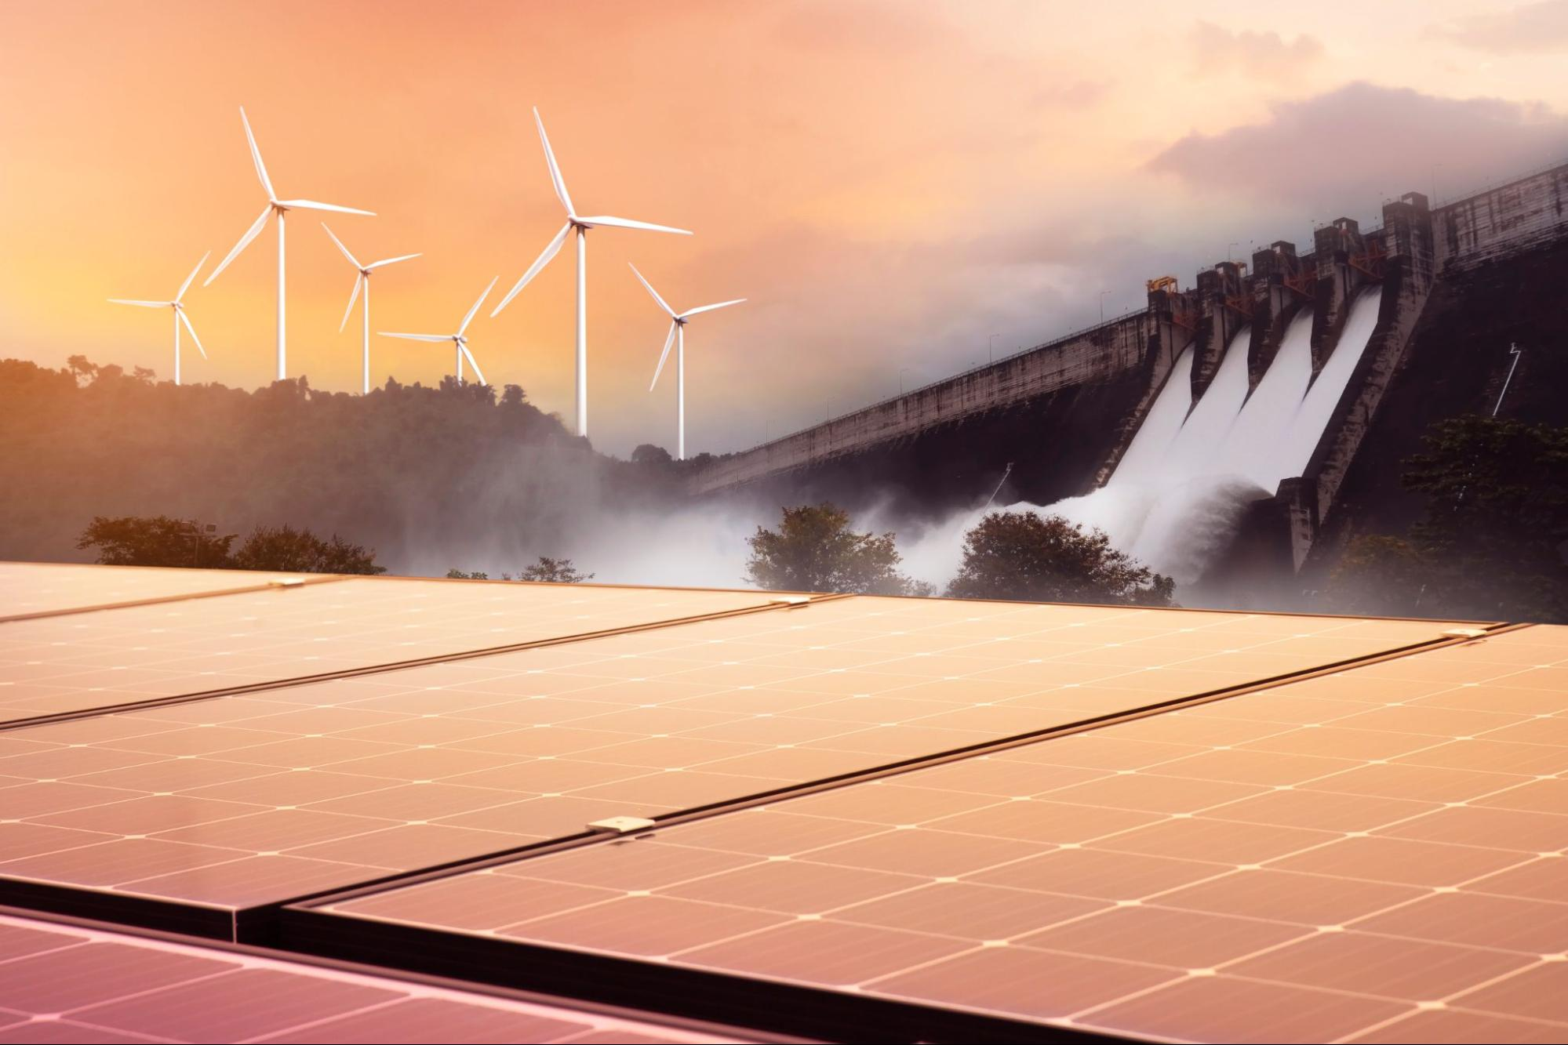
Reinvest rents in Renewable Resources

Slide 31
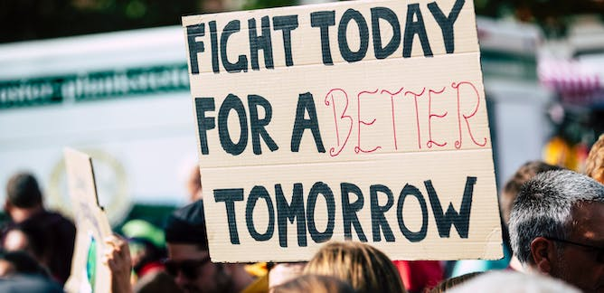
Leave Later Generations Options to be as well off as we are

